Slide 1
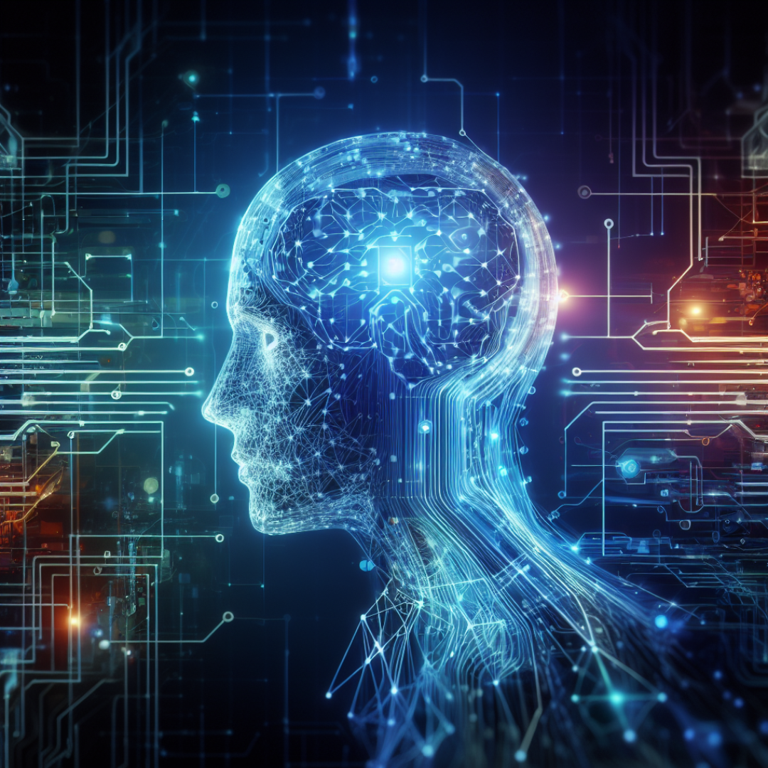
What are Neural Networks?
Neural networks are a type of machine learning algorithm that is inspired by the structure and function of the human brain.
Neural networks can learn complex patterns from data.
Neural networks have been successfully used in areas such as natural language processing.

Slide 2
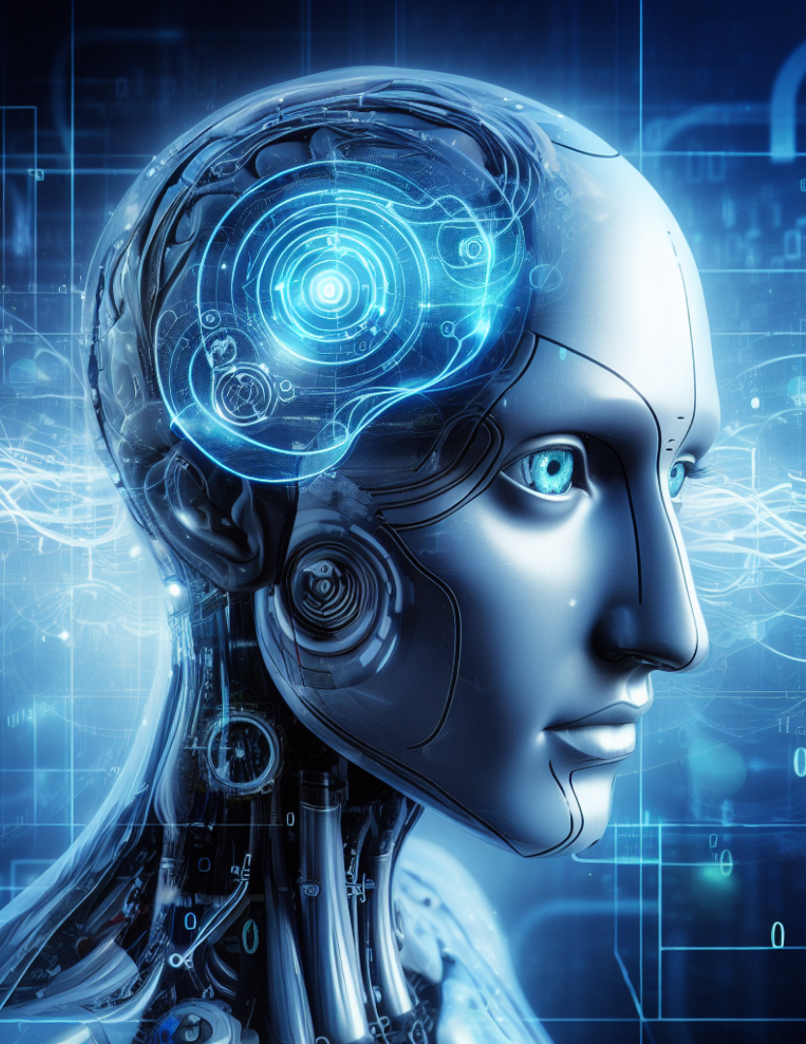
Deep Learning
Deep Learning is a type of machine learning that uses neural networks with multiple layers.
Each layer consists of multiple nodes that can perform diverse tasks. This allows deep learning models to learn more complex patterns from data.
Deep learning has been used to achieve significant results in a wide range of tasks, including image recognition, speech recognition, and machine translation.

